Slide 1

ISP550 INFORMATION SYSTEMS ENGINEERING
Topic 4: Project Planning and Initiation
Oktober 2025 – February 2026

Slide 2
Learning Objectives
Describe the project identification and selection process
Describe the steps involved in the project initiation and planning process
List and describe various methods for assessing project feasibility
Describe the classes of Internet electronic commerce applications: business-to-consumer, business-to-employee, and business-to-business

Slide 3
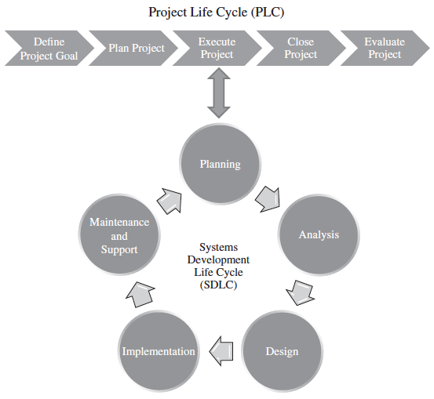
Figure 3.6 – The Project Life Cycle (PLC) and the Systems Development Life Cycle (SDLC)
Figure From the previous topic

Slide 4
Introduction
Obtaining integrated, enterprise-wide computing presents significant challenges for both corporate and information system management
The acquisition, development, and maintenance of information systems consume resources for most organizations
This leads to the need to have a formal process for identifying and selecting projects

Slide 5
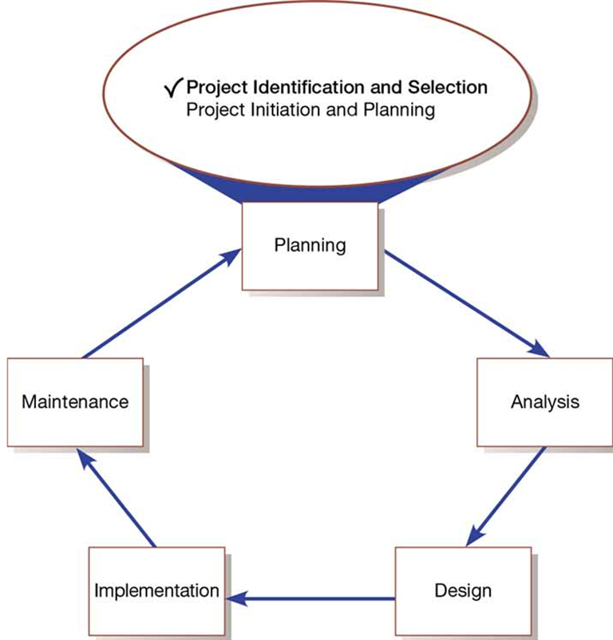
Figure 4-1: Systems Development Life Cycle with Project Identification and Selection Highlighted

Slide 6
1.Identifying and Selecting Systems Development Projects
Identifying and selecting systems development projects is part of the first phase (Planning) of the S D L C
Many firms follow a very formal process for selecting projects
Requests come from a variety of sources:
By managers needing to replace aging existing systems
By managers wanting to make a system more efficient
By managers needing a new system

Slide 7
Identifying and Selecting Projects (1 of 3)
Project identification and selection consists of three primary activities:
Identifying potential development projects
By key member of top management
By steering committee (top-down source)
By user departments (bottom-up source)
By development group or senior I S manager

Slide 8
Identifying and Selecting Projects (2 of 3)
Classifying and ranking IS development projects
Using value chain analysis or other evaluation criteria
Value chain analysis – used in analyzing an organization’s activities to determine where value is added to products and/or services and the costs incurred for doing so; it usually also includes a comparison with the activities, added value, and costs of other organizations for the purpose of making improvements in the organization’s operations and performance

Slide 9
Identifying and Selecting Projects (3 of 3)
Selecting I S development projects
Selection Method | Characteristics
Top Management | Greater strategic focus Largest project size Longest project duration Enterprise-wise consideration
Steering Committee | Cross-functional focus Greater organizational change Formal cost-benefit analysis Larger and riskier projects
Functional Area | Narrow, nonstrategic focus Faster development Fewer users, management layers, and business functions involved
Development Group | Integration with existing systems focus Fewer development delays Less concern with cost-benefit analysis
Table 4-1: Characteristics of Alternative Methods for Making Information Systems Identification and Selection Decisions

Slide 10
Table 4-2: Possible Evaluation Criteria When Classifying and Ranking Projects
Evaluation Criteria | Description
Value Chain Analysis | Extent to which activities add value and costs when developing products and/or services
Strategic Alignment | Extent to which the project is viewed as helping the organization achieve its strategic objectives and long-term goals
Potential Benefits | Extent to which the project is viewed as improving profits, customer service, and so forth, and the duration of these benefits
Resource Availability | Amount and type of resources the project requires and their availability
Project Size/Duration | Number of individuals and the length of time needed to complete the project
Technical Difficulty/Risks | Level of technical difficulty to successfully complete the project within given time and resource constraints

Slide 11
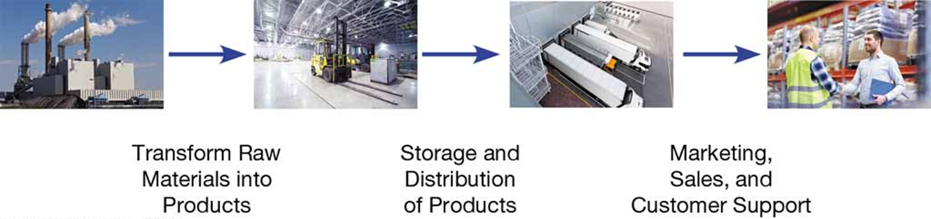
Figure 4-1: Organizations Can Be Thought of as a Value Chain, Transforming Raw Materials into Products for Customers
(Sources: Left to right: Bram van Broekhoven/Shutterstock; Alexey Fursov/Shutterstock; Hacohob/Shutterstock; Syda Productions/Shutterstock)

Slide 12
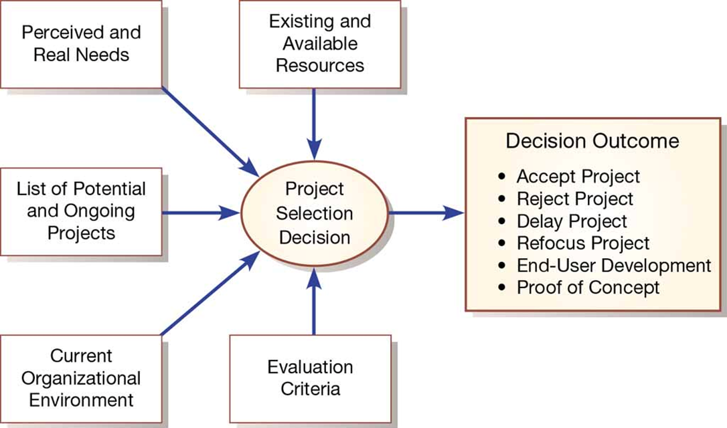
Figure 4-2: Project Selection Decisions Must Consider Numerous Factors and Can Have Numerous Outcomes

Slide 13
Table 4-3: Elements of Project Initiation
Elements of Project Initiation
Establishing the project initiation team
Establishing a relationship with the customer
Establishing the project initiation plan
Establishing management procedures
Establishing the project management environment and project workbook
Developing the project charter
#Refer Topic 3, slide 12

Slide 14
Table 4-4: Elements of Project Planning
Elements of Project Planning
Describing the project scope, alternatives, and feasibility
Dividing the project into manageable tasks
Estimating resources and creating a resource plan
Developing a preliminary schedule
Developing a communication plan
Determining project standards and procedures
Identifying and assessing risk
Creating a preliminary budget
Developing the project scope statement
Setting a baseline project plan
#Refer Topic 3, slide 15

Slide 15
Deliverables and Outcomes (1 of 2)
Business case – justification for an information system, presented in terms of the tangible and intangible economic benefits and costs and the technical and organizational feasibility of the proposed system
Baseline Project Plan (B P P) – major outcome and deliverable from the project initiation and planning phase that contains the best estimate of a project’s scope, benefits, costs, risks, and resource requirements
Project Scope Statement (P S S) – document prepared for the customer that describes what the project will deliver and outlines generally at a high level all work required to complete the project

Slide 16
2. Initiation and Planning Projects
When does project initiation and planning (P I P) end and execution begin?
Three important questions must be considered when making this decision:
How much effort should be expended on the project initiation and planning phase?
Who is responsible for performing the project initiation and planning process?
Why is project initiation and planning such a challenging activity?

Slide 17
Assessing Project Feasibility
Most feasibility factors are represented by the following categories:
Economic
Technical
Operational
Scheduling
Legal and contractual
Political

Slide 18
Assessing Economic Feasibility
Economic feasibility – process of identifying the financial benefits and costs associated with a development project
Tangible benefit – benefit from the creation of an information system that can be measured in dollars and with certainty
Most tangible benefits:
Cost reduction and avoidance
Error reduction
Increased flexibility
Increased speed of activity
Improvement of management planning and control
Opening new markets and increasing sales opportunities
Intangible benefit – benefit derived from the creation of an information system that cannot be easily measured in dollars or with certainty (See Table 4-5)

Slide 19
Table 4-5: Intangible Benefits from the Development of an Information System
Intangible Benefits from the Development of an I S | Intangible Benefits from the Development of an I S
Competitive necessity | More confidence in decision quality
More timely information | Improved processing efficiency
Improved organizational planning | Improved asset utilization
Increased organizational flexibility | Improved resource control
Promotion of organizational learning and understanding | Increased accuracy in clerical operations
Availability of new, better, or more information | Improved work process that can improve employee moral or customer satisfaction
Ability to investigate more alternatives | Positive impacts on society
Faster decision making | Improved social responsibility
Better usage of resources (“greener”) | Blank
(Source: Based on Parker & Benson, 1988; Brynjolfsson & Yang, 1997; Keen, 2003; Cresswell, 2004)

Slide 20
Assessing Technical Feasibility
Technical feasibility – process of assessing the development organization’s ability to construct a proposed system
Potential consequences of not accessing and managing risks can include the following:
Failure to attain expected benefits from the project
Inaccurate project cost estimates
Inaccurate project duration estimates
Failure to achieve adequate system performance levels
Failure to adequately integrate the new system with existing hardware, software, organizational procedures

Slide 21
Assessing Other Feasibility Concerns
Operational feasibility – process of assessing the degree to which a proposed system solves business problems or takes advantage of business opportunities
Schedule feasibility – process of assessing the degree to which the potential time frame and completion dates for all major activities within a project meet organizational deadlines and constraints for affecting change
Legal and contractual feasibility – process of assessing potential legal and contractual ramifications due to the construction of a system
Political feasibility – process of evaluating how key stakeholders within the organization view the proposed system

Slide 22
ELECTRONIC COMMERCE APPLICATIONS: IDENTIFYING AND SELECTING SYSTEMS DEVELOPMENT PROJECTS
Identifying and selecting systems development projects for an Internet-based electronic commerce application is no different from the process followed for more traditional applications.
Nonetheless, there are some special considerations when developing an Internet-based application.
In this section, we highlight some of those issues that relate directly to the process of identifying and selecting Internet-related systems development projects.

Slide 23
Internet Basics
Internet – large, worldwide network of networks that use a common protocol to communicate with each other
Internet of Things (I o T) – broad class of physical objects that feature an Internet address and connectivity that communicate between these objects and other Internet enabled devices and systems
Electronic commerce (E C) – Internet-based communication to support day-to-day government, business, and consumer activities

Slide 24
E C Business Models
A broad range of business models include:
Business-to-Business (B 2 B)
Business-to-Consumer (B 2 C)
Consumer-to-Consumer (C 2 C)
Consumer-to-Business (C 2 B)
Business-to-Government (B 2 G)
Government-to-Business (G 2 B)
Government-to-Citizen (G 2 C)
Thing-to-Thing (T 2 T)

Slide 25
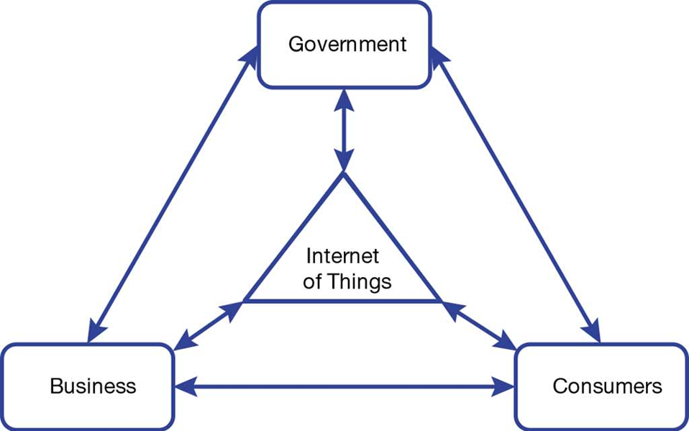
Figure 4-3: The Internet of Everything

Slide 26
Table 4-6: Unknowns That Must Be Dealt with When Designing and Building Internet Applications
Factor | Unknowns That Must Be Dealt With
User | Concern: Who is the user? Example: Where is the user located? What is the user’s expertise or education? What are the user’s expectations?
Connection Speed | Concern: What is the speed of the connection and what information can be effectively transported? Example: WiFi, cellular
Access Method | Concern: What is the connection device? Example: Web browser, tablet, smartphone, smart watch

Slide 27
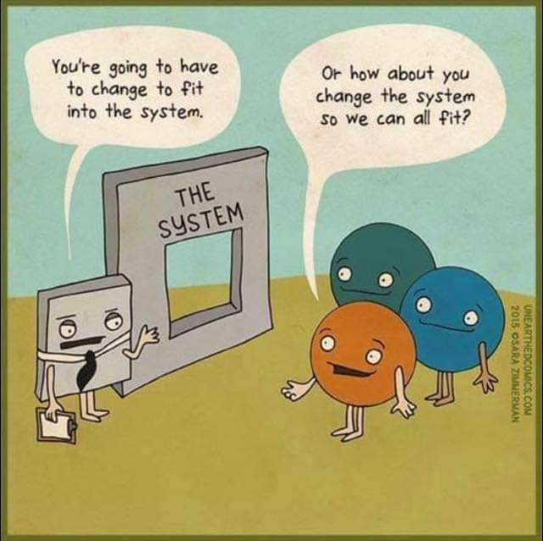

Slide 28

In this chapter you learned to:
Describe the project identification and selection process
Describe the steps involved in the project initiation and planning process
List and describe various methods for assessing project feasibility
Describe the classes of Internet electronic commerce applications: business-to-consumer, business-to-employee, and business-to-business

